Slide 1
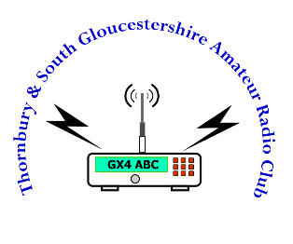
Data Modes Starter
Presented by
Paul 2E0PSM
Notes:
BPSK31 QPSK31 BPSK63 MFSK16 RTTY CW Helleschreiber SSTV MT63 Throb Packet JT65 WSPR Contestia Olivia Thor Throb Martin Robot Scottie APRS AX25 ALE AMTOR PACTOR G-TOR Clover

Slide 2
Modes (to name but a few)

Slide 3
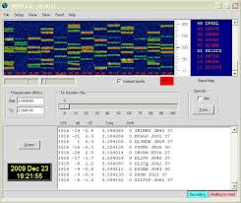
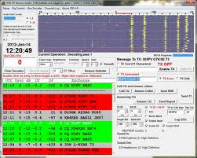
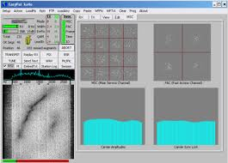
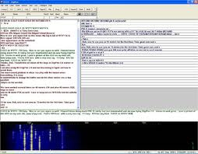
Software
Ham Radio Deluxe (Multiple Modes including SSTV)
JT65-HF
Digipan (PSK31)
WSPR
Fldigi
WinPSK
EasyPal

Slide 4
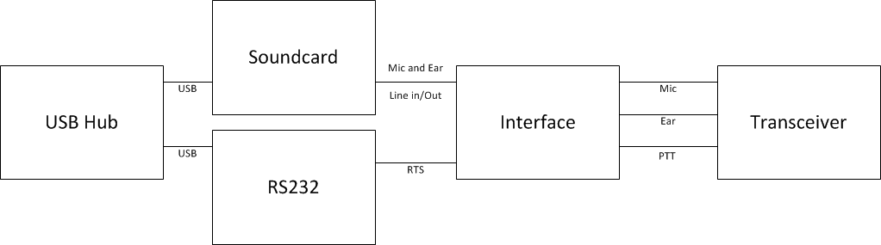
Interfacing Block Diagram

Slide 5
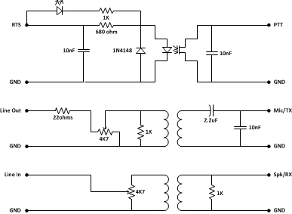
Interface Circuit

Slide 6
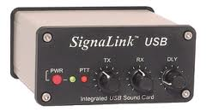
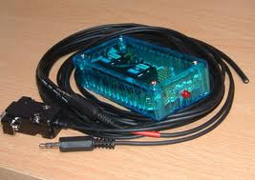
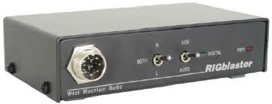
Ready Made Interfaces
Rigblaster
Signalink
M0AQC

Slide 7
Audio & Modulation
Pointers
  Set ALC to minimal if not off
  Set AGC to off
  Turn of all DSP functions
  Turn down RX/Mic volume input to PC

