Slide 1
SDR 3-Aug-2016
Part 1 – Overview
G0RVM

Slide 2
What is SDR?
Software Defined Radio
A/D conversion of RF spectrum
One or more parts of RF spectrum simultaneously converted
Some analogue RF & IF stages still necessary / best done ‘traditionally’
‘Heavy-lifting’ done in fast FPGAs
Filters, modulation etc performed in software / programmable DSPs

Slide 3
What is SDR?
ADC/DAC
DSP
Multi purpose computer
Analogue domain
Digital domain
Modern SDR places ADC/DAC as far to the left as possible
Avoids VFO, LO IF conversion, bandpass filters
Needs fast ADC/DAC
High data rates

Slide 4
Why SDR?
With black box radio’s capacity for change is very limited
buttons, knobs - fixed
scope for filtering restricted – e.g. new multi-notch and noise reduction
new modulation schemes not possible. E.g. Adding SSB to FM only radio
Software can easily be changed
its flexible
reduced obsolescence
greater scope for experimentation
convergence of analogue and digital domains
greater sensitivity and selectivity

Slide 5
Why SDR?
Interfacing simplicity:
sound card interfaces – gone
CAT cables – gone
multiple ground-loops – gone
different pin-outs, connectors and levels - gone
Virtual cabling rules! ☺
interfaces can span geographies
Virtual receivers
listen/watch multiple bands simultaneously

Slide 6
Why SDR?
Filters:
brick-walls
wide, narrow
user-definable
multi-notch etc
new software can improve filters, add new filters…
Potential to operate remotely
See signals not just hear them!
monitor a band visually for activity
panadapters, waterfalls, audio spectrum
new displays added easily by developers

Slide 7
Why SDR?

Slide 8
Why SDR?

Slide 9
Why SDR?
Simpler to use:
TS-990 vs SDR comparison (next slide)
why have all those buttons?
just show the ones relevant for what you are doing!

Slide 10
Why SDR?

Slide 11
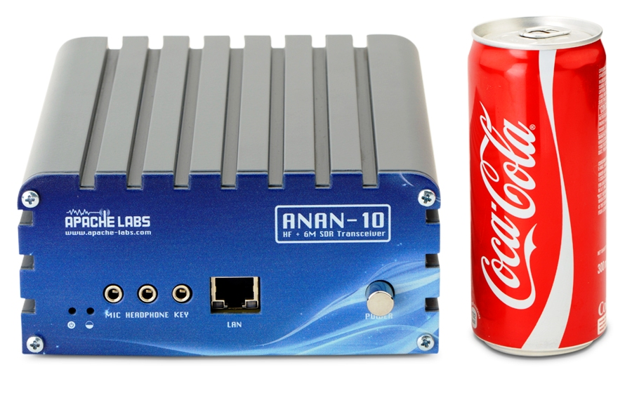
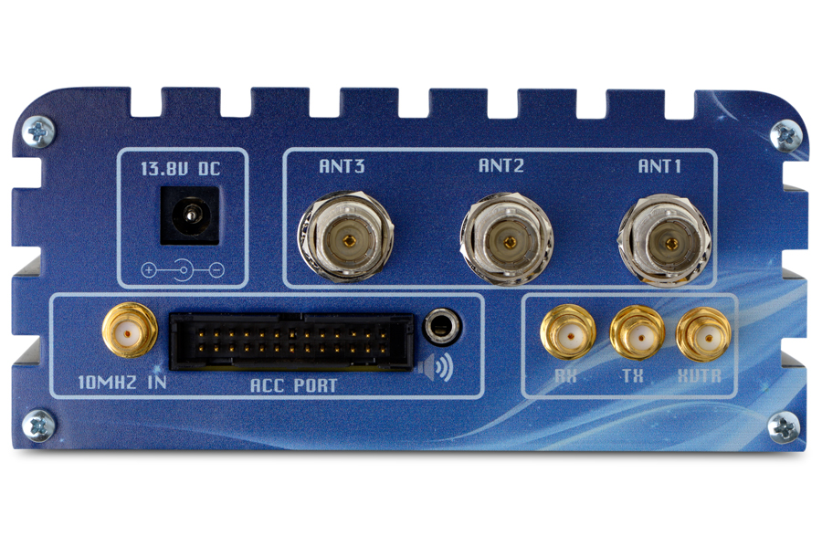
Why SDR?
Small and light!

Slide 12
Why SDR?
Several manufacturers
ANAN – Productised TAPR boards – Hermes, Angelina…
Flex Radio
Airspy, RTL-SDR, Funcube etc (Receivers)
Kits readily available
TAPR
SDR-Kits
etc, etc lots of them...
Can be cheap or expensive
But always significantly cheaper than ‘traditional’ radios

Slide 13
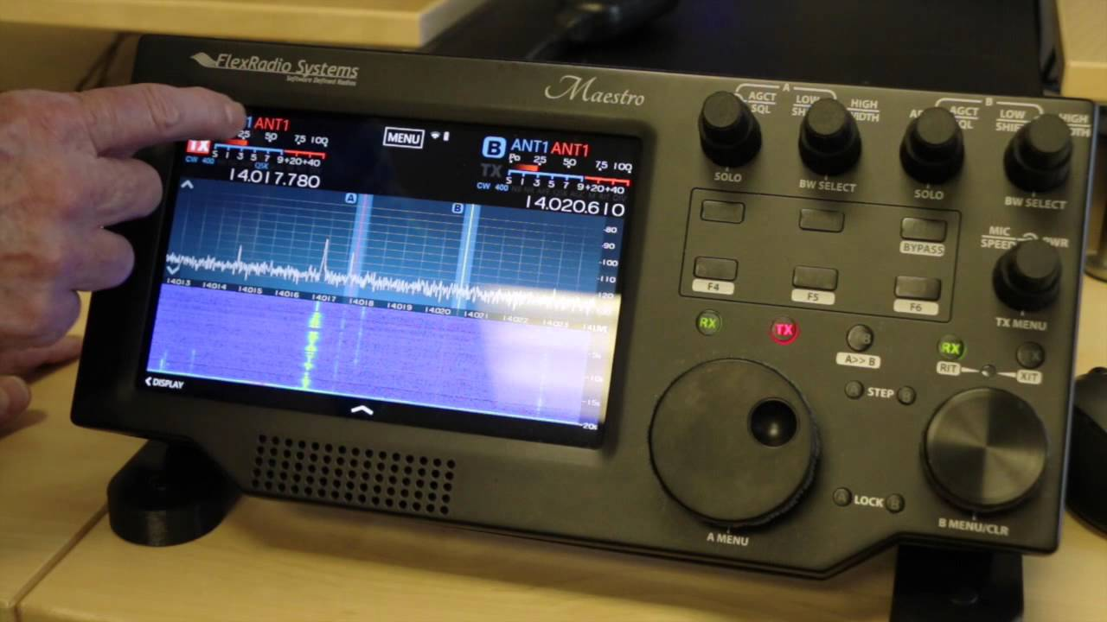
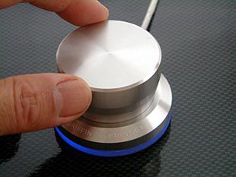
Why SDR?
But you:
want knobs and not to use a computer
well that’s ok too ☺

Slide 14
IQ Signals
IQ tutorial (19 mins)
https://www.youtube.com/watch?v=h_7d-m1ehoY

Slide 15
The End
Thank you

