Slide 1
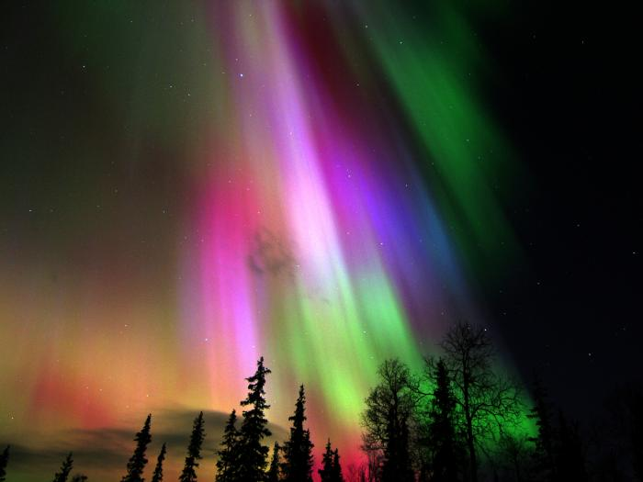
VHF Propagation Overview 5-Oct-2016
G0RVM

Slide 2
VHF Propagation
Where in the radio spectrum is VHF?
30MHz to 300MHz
for radio amateurs its 50MHz, 70MHz & 144MHz or 6m, 4m & 2m
Name some types of VHF propagation?
Beacons
What are they?
Why are they so important?

Slide 3
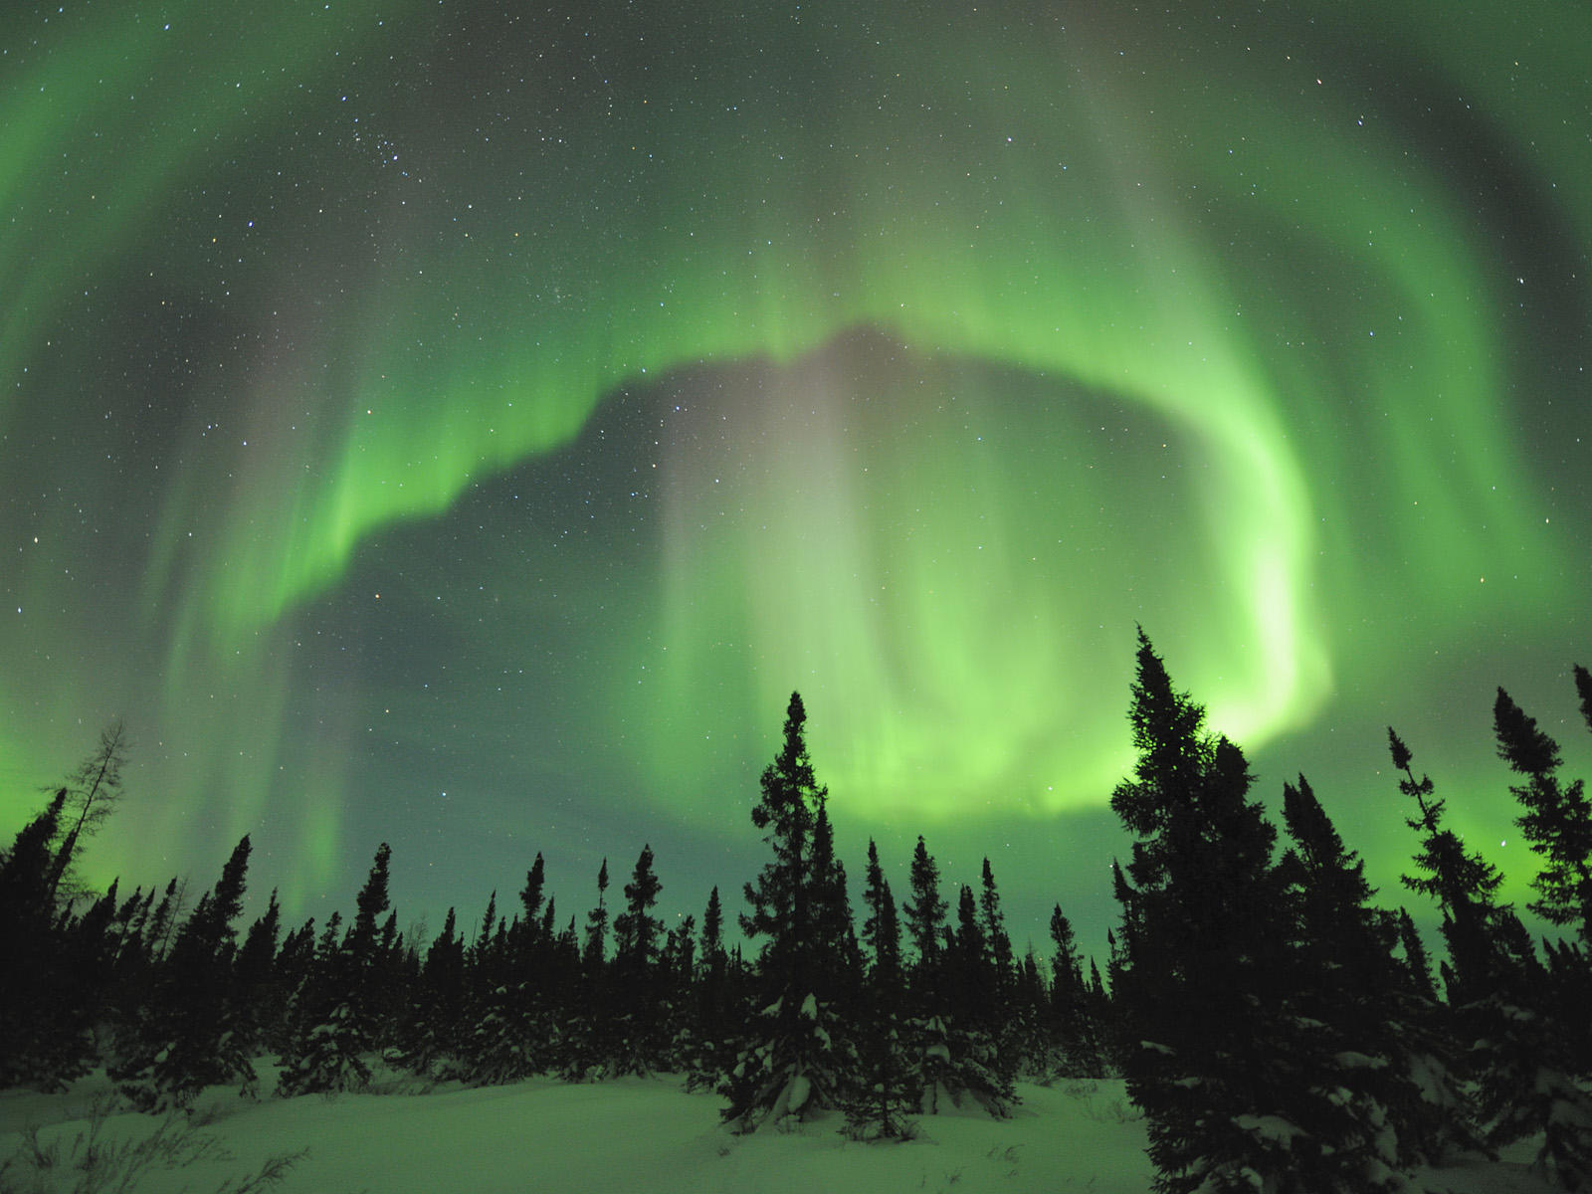
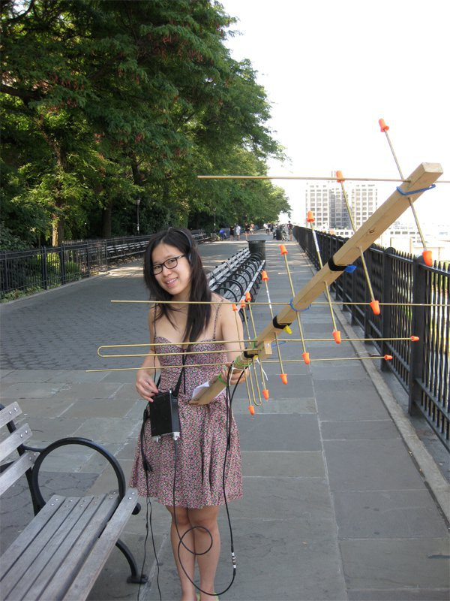
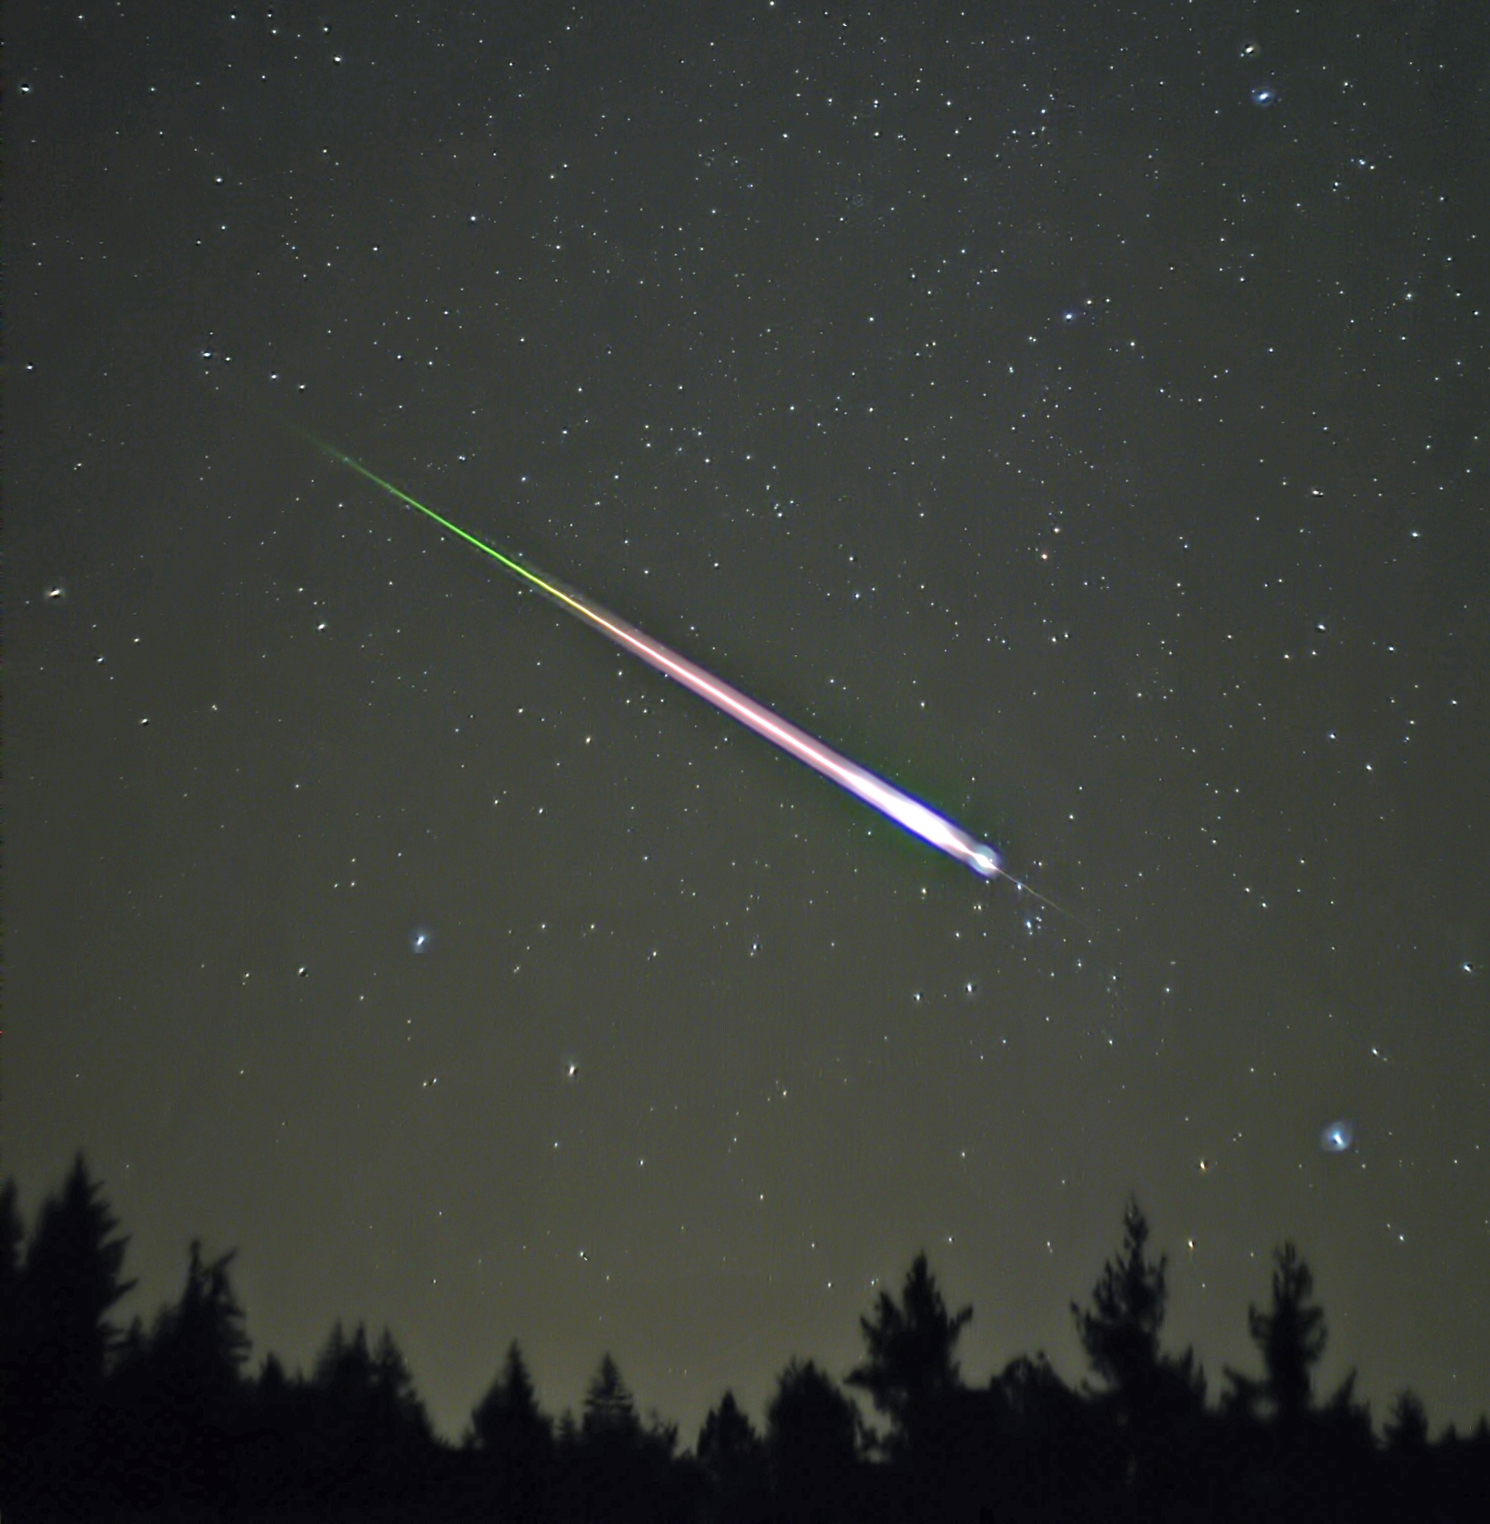
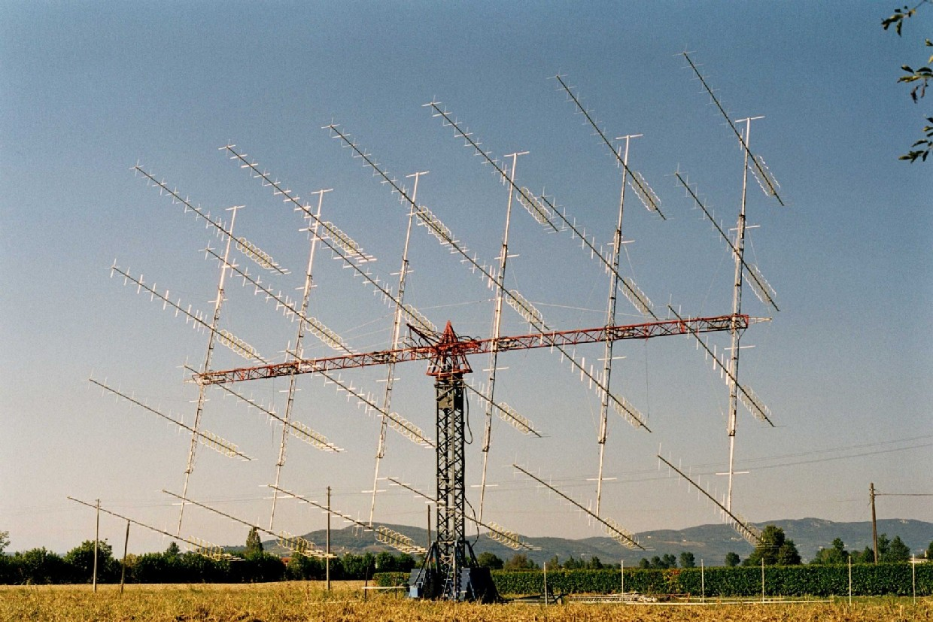
VHF Propagation
Modes
Ground wave
Tropospheric
Ionospheric
Aurora
Meteor scatter
Moon bounce
Man-made satellite.
Notes:
Not a definitive list but the main ones

Slide 4
VHF Propagation
Notes:
Not a definitive list but the main ones

Slide 5
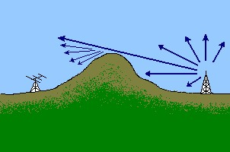
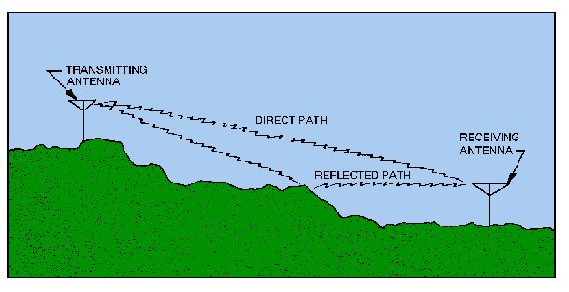
Ground Wave
Direct path
Reflection
Angle of incidence equal angle of reflection
Big buildings & mountains can be useful!
Diffraction
bending around corners of obstacle or aperture into a region of shadow of the obstacle.
Scatter (All modes)
process whereby radio signals are forced to deviate from a straight trajectory by localised non-uniformities in the medium through which they pass.
Examples: Side, back and forward scatter.

Slide 6
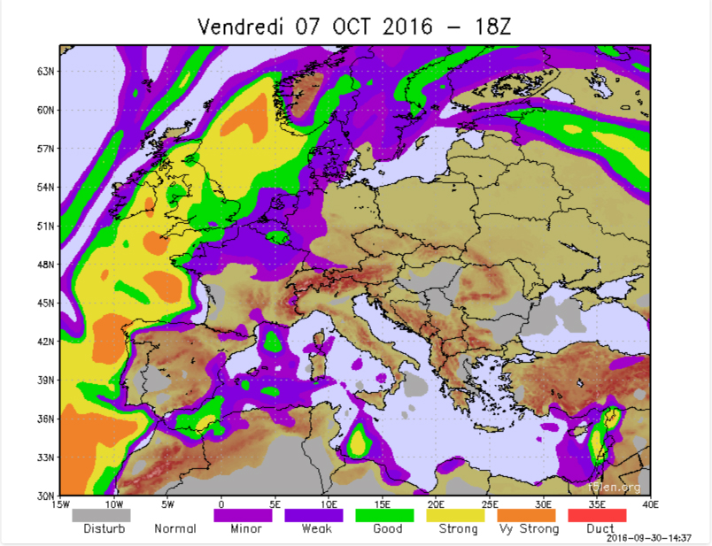
Tropospheric
Where is the troposphere?
starts at the surface - goes up to 7 to 20km (4 to 12miles)
Distances achievable
Single enhancement effect : approx. 1600km/1000miles
Modes: All
When does it occur?
during very settled, warm anticyclonic weather (high pressure), weak signals from distant stations improve in strength
favours signals travelling along the prevailing isobar pattern (rather than across it)
such weather conditions can occur at any time, but generally the summer and autumn months are the best periods.
What is it?
boundary/temperature gradients between layers in the troposphere
temperature inversions & fog.
Prediction
Two excellent Internet sites: See [HEPB] and [FLEN]

Slide 7
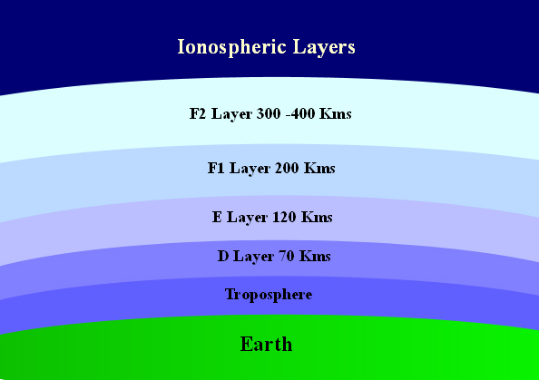
Ionospheric
E-Layer & F-Layer when solar activity is high
E-Layer : 6m, 4m & 2m
F-Layer : 6m
Distances achievable (single hop)
F2 Layer – approx. 3200km/2000miles
E Layer – approx. 1500kms/1000miles
Modes:
All
Es – Dense patches of ionisation
When does it occur?
periods of high solar activity
Es - Spring
Prediction
monitor solar activity [SACT]
real-time MUF & Critical frequency Internet sites. [RMUF]
real-time contact maps. [DXMP]

Slide 8
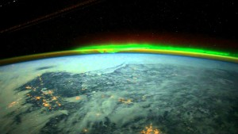
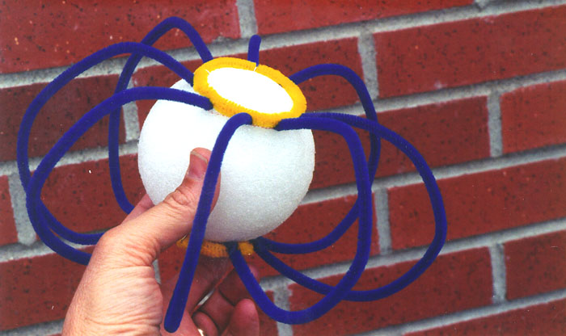
Aurora
High energy particles from Sun interacting with atoms in Earth atmosphere
Blue : Ionised Nitrogen
Green : Oxygen
Red : Excited Nitrogen.
Particles dragged into polar regions as they follow Earth’s magnetic field lines
Curtains of incoming particles refract radio signals
Both stations need ‘sight’ of aurora
Listen to the North/North East
Nasty Distorted/raspy sounding signals
Modes:
All, but narrowband more effective, less distorted
Auroral propagation needs an active Sun
Not necessarily dependent on 11yr cycle
Prediction: [SACT], [AUOV], [DXMP], [BOO2]

Slide 9
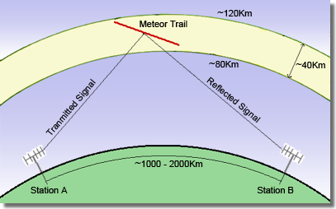
Meteor scatter
Billions of particles, meteors, enter Earth's atmosphere every day
Small fraction have properties useful for communication
As meteors burn up, they create a trail of ionized particles in the E-layer that can persist for up to several seconds
A single two-way exchange may need several meteors
Distance over which contacts can be established determined by:
altitude at which the ionisation is created
location over the surface of the Earth where the meteor is falling
angle of entry into the atmosphere
relative locations of stations attempting communication.

Slide 10
Meteor scatter
Due to short reflection duration:
contacts arranged out-of-band (e.g. ON4KST)
Information transmitted repeatedly for a time-period
High-speed Morse (up to 800wpm !) superseded by:
FSK441, JT6M
Ionised trails can also be caused by aircraft
Aircraft fly to known schedules!
Aircraft location info on Internet:
[PFND], [FRAD] & [RADV]

Slide 11
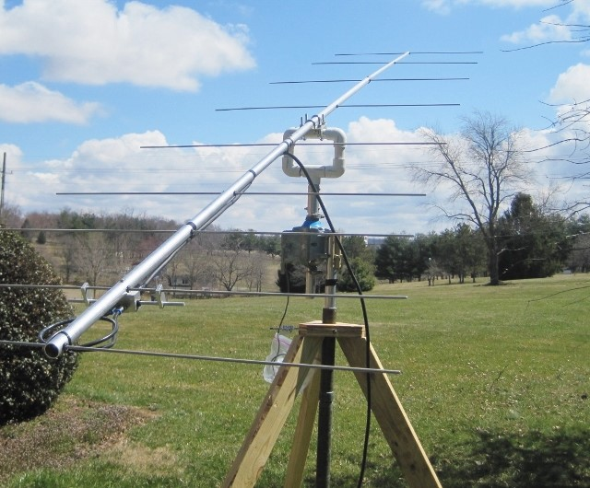
Moon bounce (EME)
Not strictly propagation
Proposed by GPO in 1940
Developed by US after WWII. Echo’s received in 1946.
teletype link between Pearl harbour and Washington!
Moon must be above horizon of both stations
Weak signals – low noise, low loss, high gain systems needed
Return delay:
2.4 secs at perigee
2.7 secs at apogee
2.56 secs on average.
6m to 6cms (50 MHz to 47 GHz) used successfully for EME
popular bands: 2m, 70cms & 23cms
Modes: JT65B, Morse, even phone – but latter needs greater link budget
Big arrays not necessary with a mode like JT65
Successful contacts with 100w and a single Yagi.

Slide 12
Man-made satellite
Not strictly propagation
Popular mode for working long distance…
Long distance – two geographically distant points on the Earth
Two-way: telephony and digital modes (FM, SSB and CW)
One-way: telemetry reception (data and some Morse!)
Big subject and very relevant to modern communications
AMSAT is the international AMateur SATellite body. AMSAT-UK is UK body
Huge resource for amateur satellite information
OSCAR - Orbital Satellite Carrying Amateur Radio
Global communications
Store and forward messaging using AX.25 (ISS & earlier generation satellites)
Both ground stations have satellite visibility.
Better experience with steerable (Az & El) antenna’s
Need to take account of Doppler.

Slide 13
Hints & Tips
Get on the bands and listen
beacons
noise levels
activity.
Monitor solar activity
Monitor weather systems
Watch Internet sites:
Real-time MUF & Critical frequency Internet sites
DX Maps – real-time contacts
Watch the weather (TV, Radio, atmospheric pressure charts)
Hepburn & F5LEN.

Slide 14
References & Links
[HEPB] - Hepburn : http://www.dxinfocentre.com/tropo_nwe.html
[FLEN] - F5LEN : http://tropo.f5len.org/forecasts-for-europe/
[DXMP] - DXMaps : http://www.dxmaps.com/spots/map.php?Lan=E&Frec=144&ML=M&Map=EU&DXC=N&HF=N&GL=N
[METO] - Met office: http://www.metoffice.gov.uk/mobile/surface-pressure/
[RSGB] - RSGB : http://rsgb.org/main/get-started-in-amateur-radio/operating-your-new-station/vhfuhf-propagation/
[AUPR] – RSGB : http://rsgb.org/main/technical/propagation/auroal-propagation/
[AUOV] - Auroral oval (Apple Appstore)
[RMUF] - Realtime MUF map : http://www.spacew.com/www/realtime.php
[SACT] – Solar Ham : http://www.solarham.net
[MMMV] – Make More Miles on VHF : http://www.mmmonvhf.de/index.php
[PFND] – Plane Finder : http://planefinder.net
[FRAD] – Flight Radar : http://www.flightradar24.com
[RADV] – Virtual Radar : http://www.radarvirtuel.com
[BOK1] - VHF UHF Manual, G.R.Jessop, G6JP, Fourth Edition, ISBN 0-900612-63-0
[BOO2] - Radio Auroras, Charlie Newton, G2FKZ, ISBN: 9781-9050-8681-8
[BOO3] - Amateur Radio Operating Manual, Third edition, R.J. Eckersley, G4FTJ, ISBN 0-9006612-69-X

Slide 15
The End
Thank you

