Slide 1
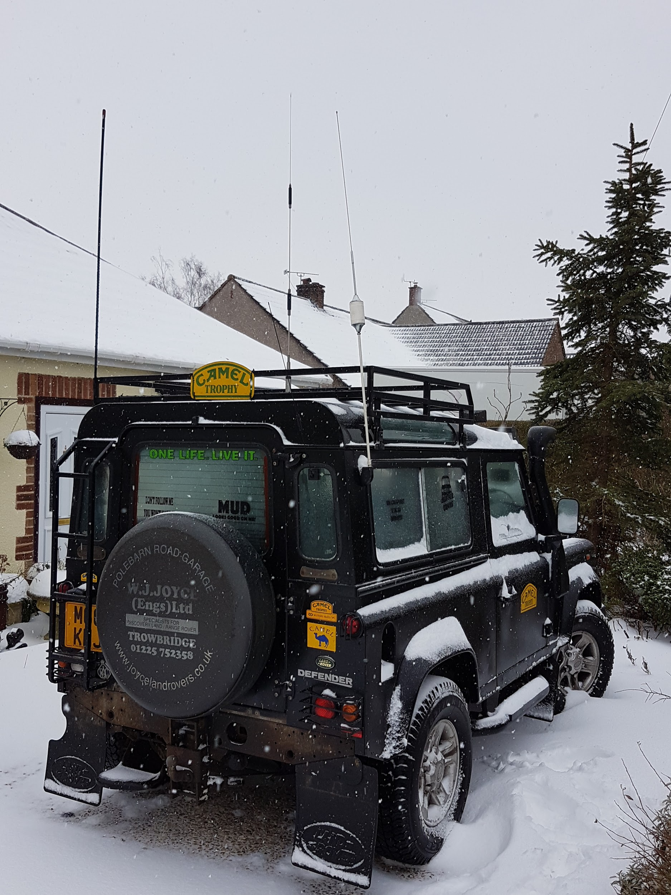
Mobile HF
Shack in a box
Mark M0RZS

Slide 2
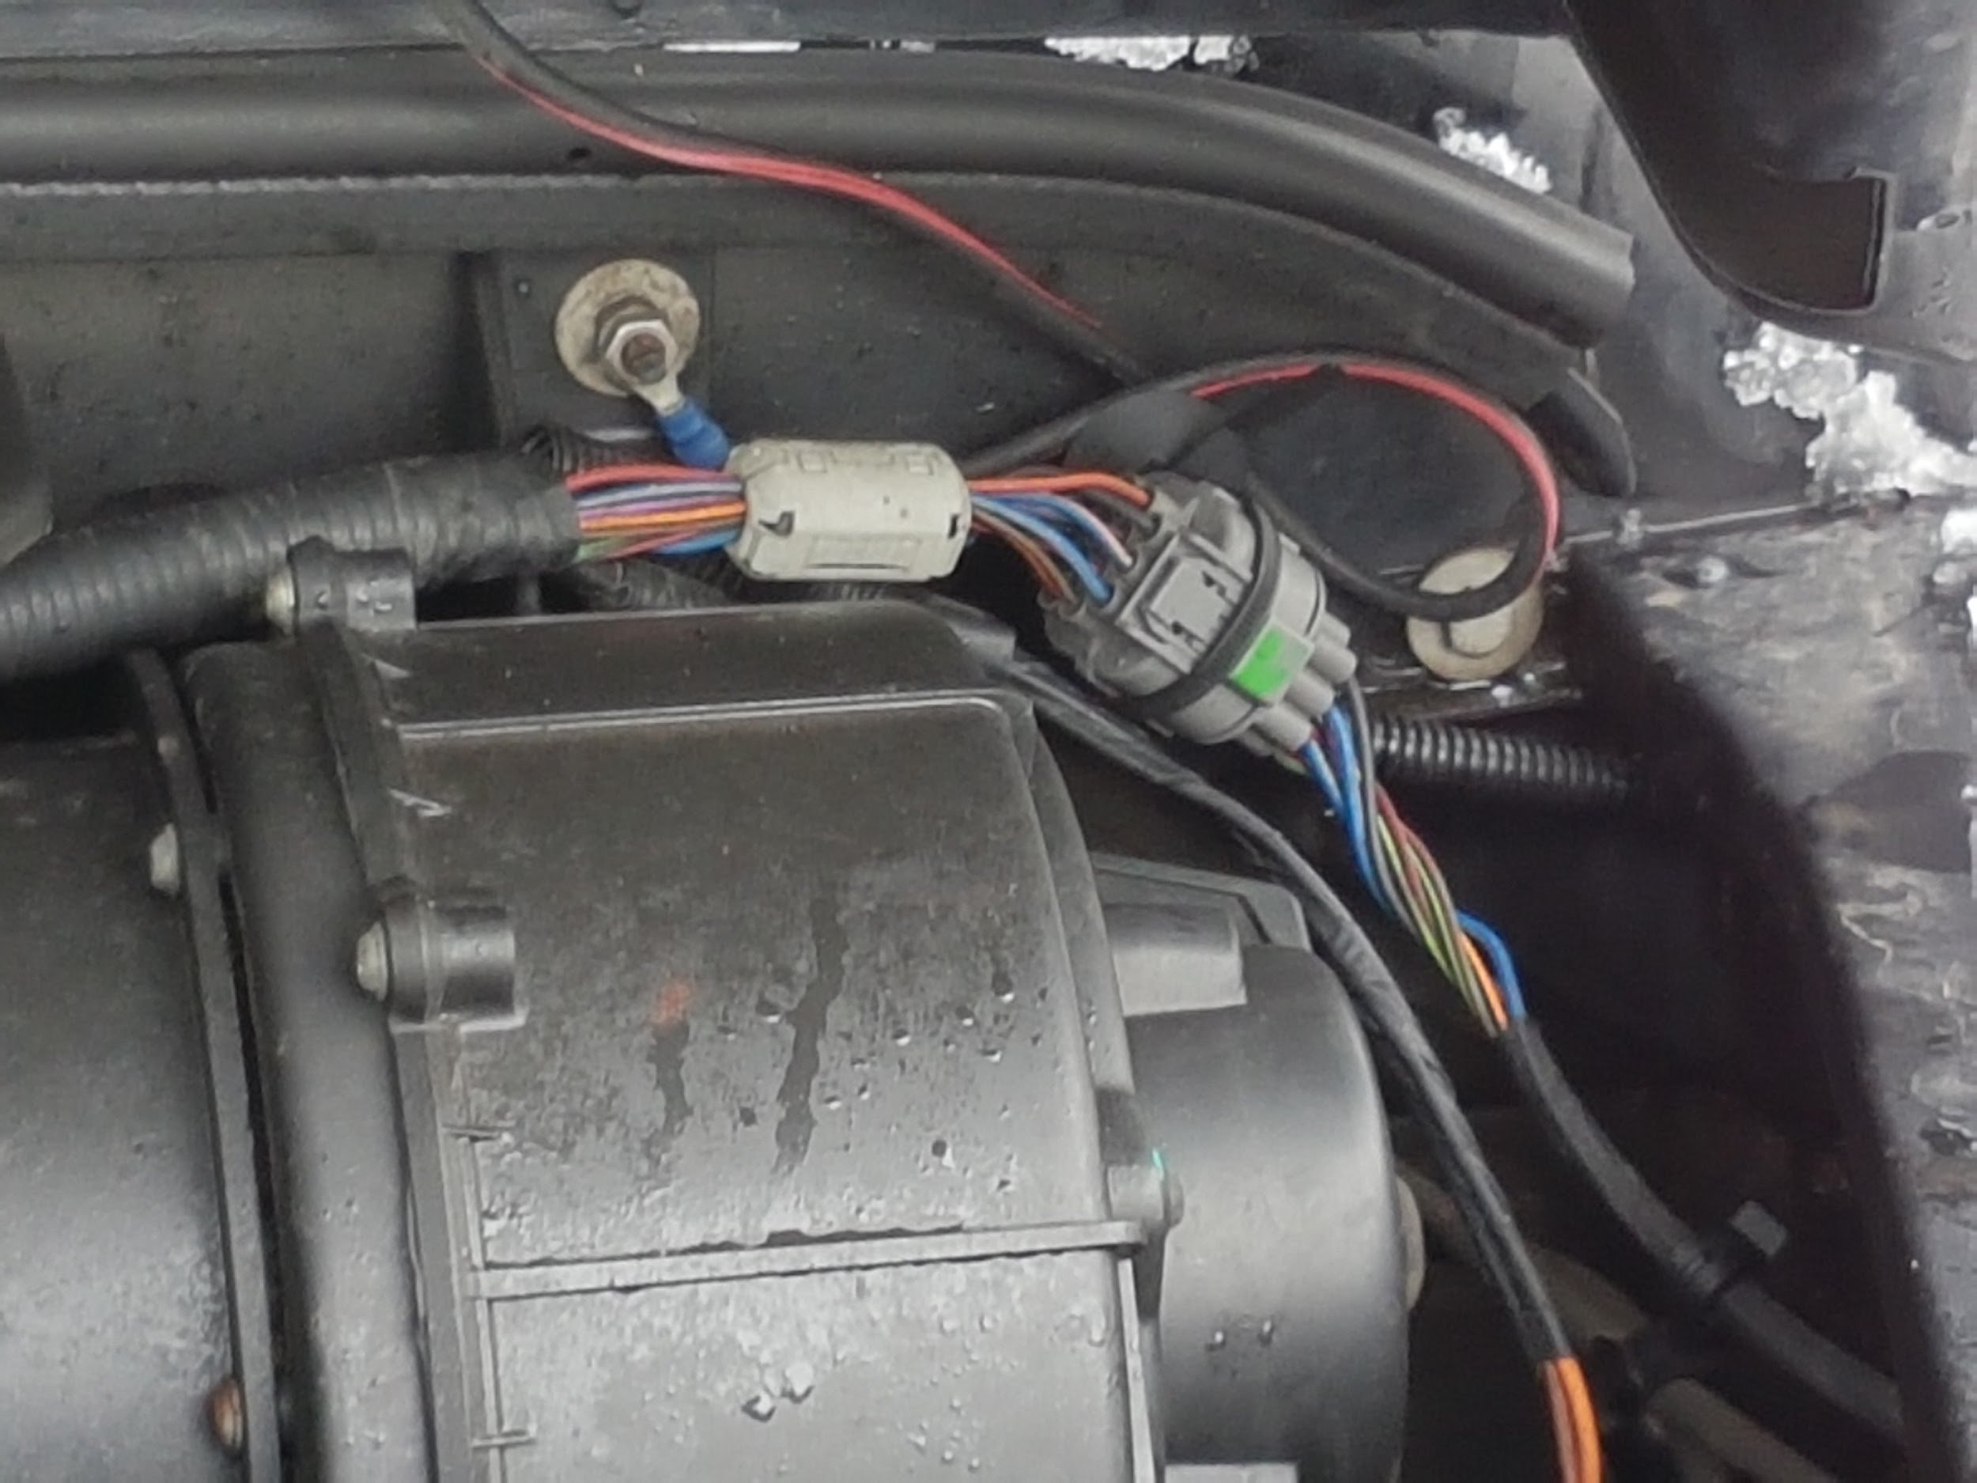
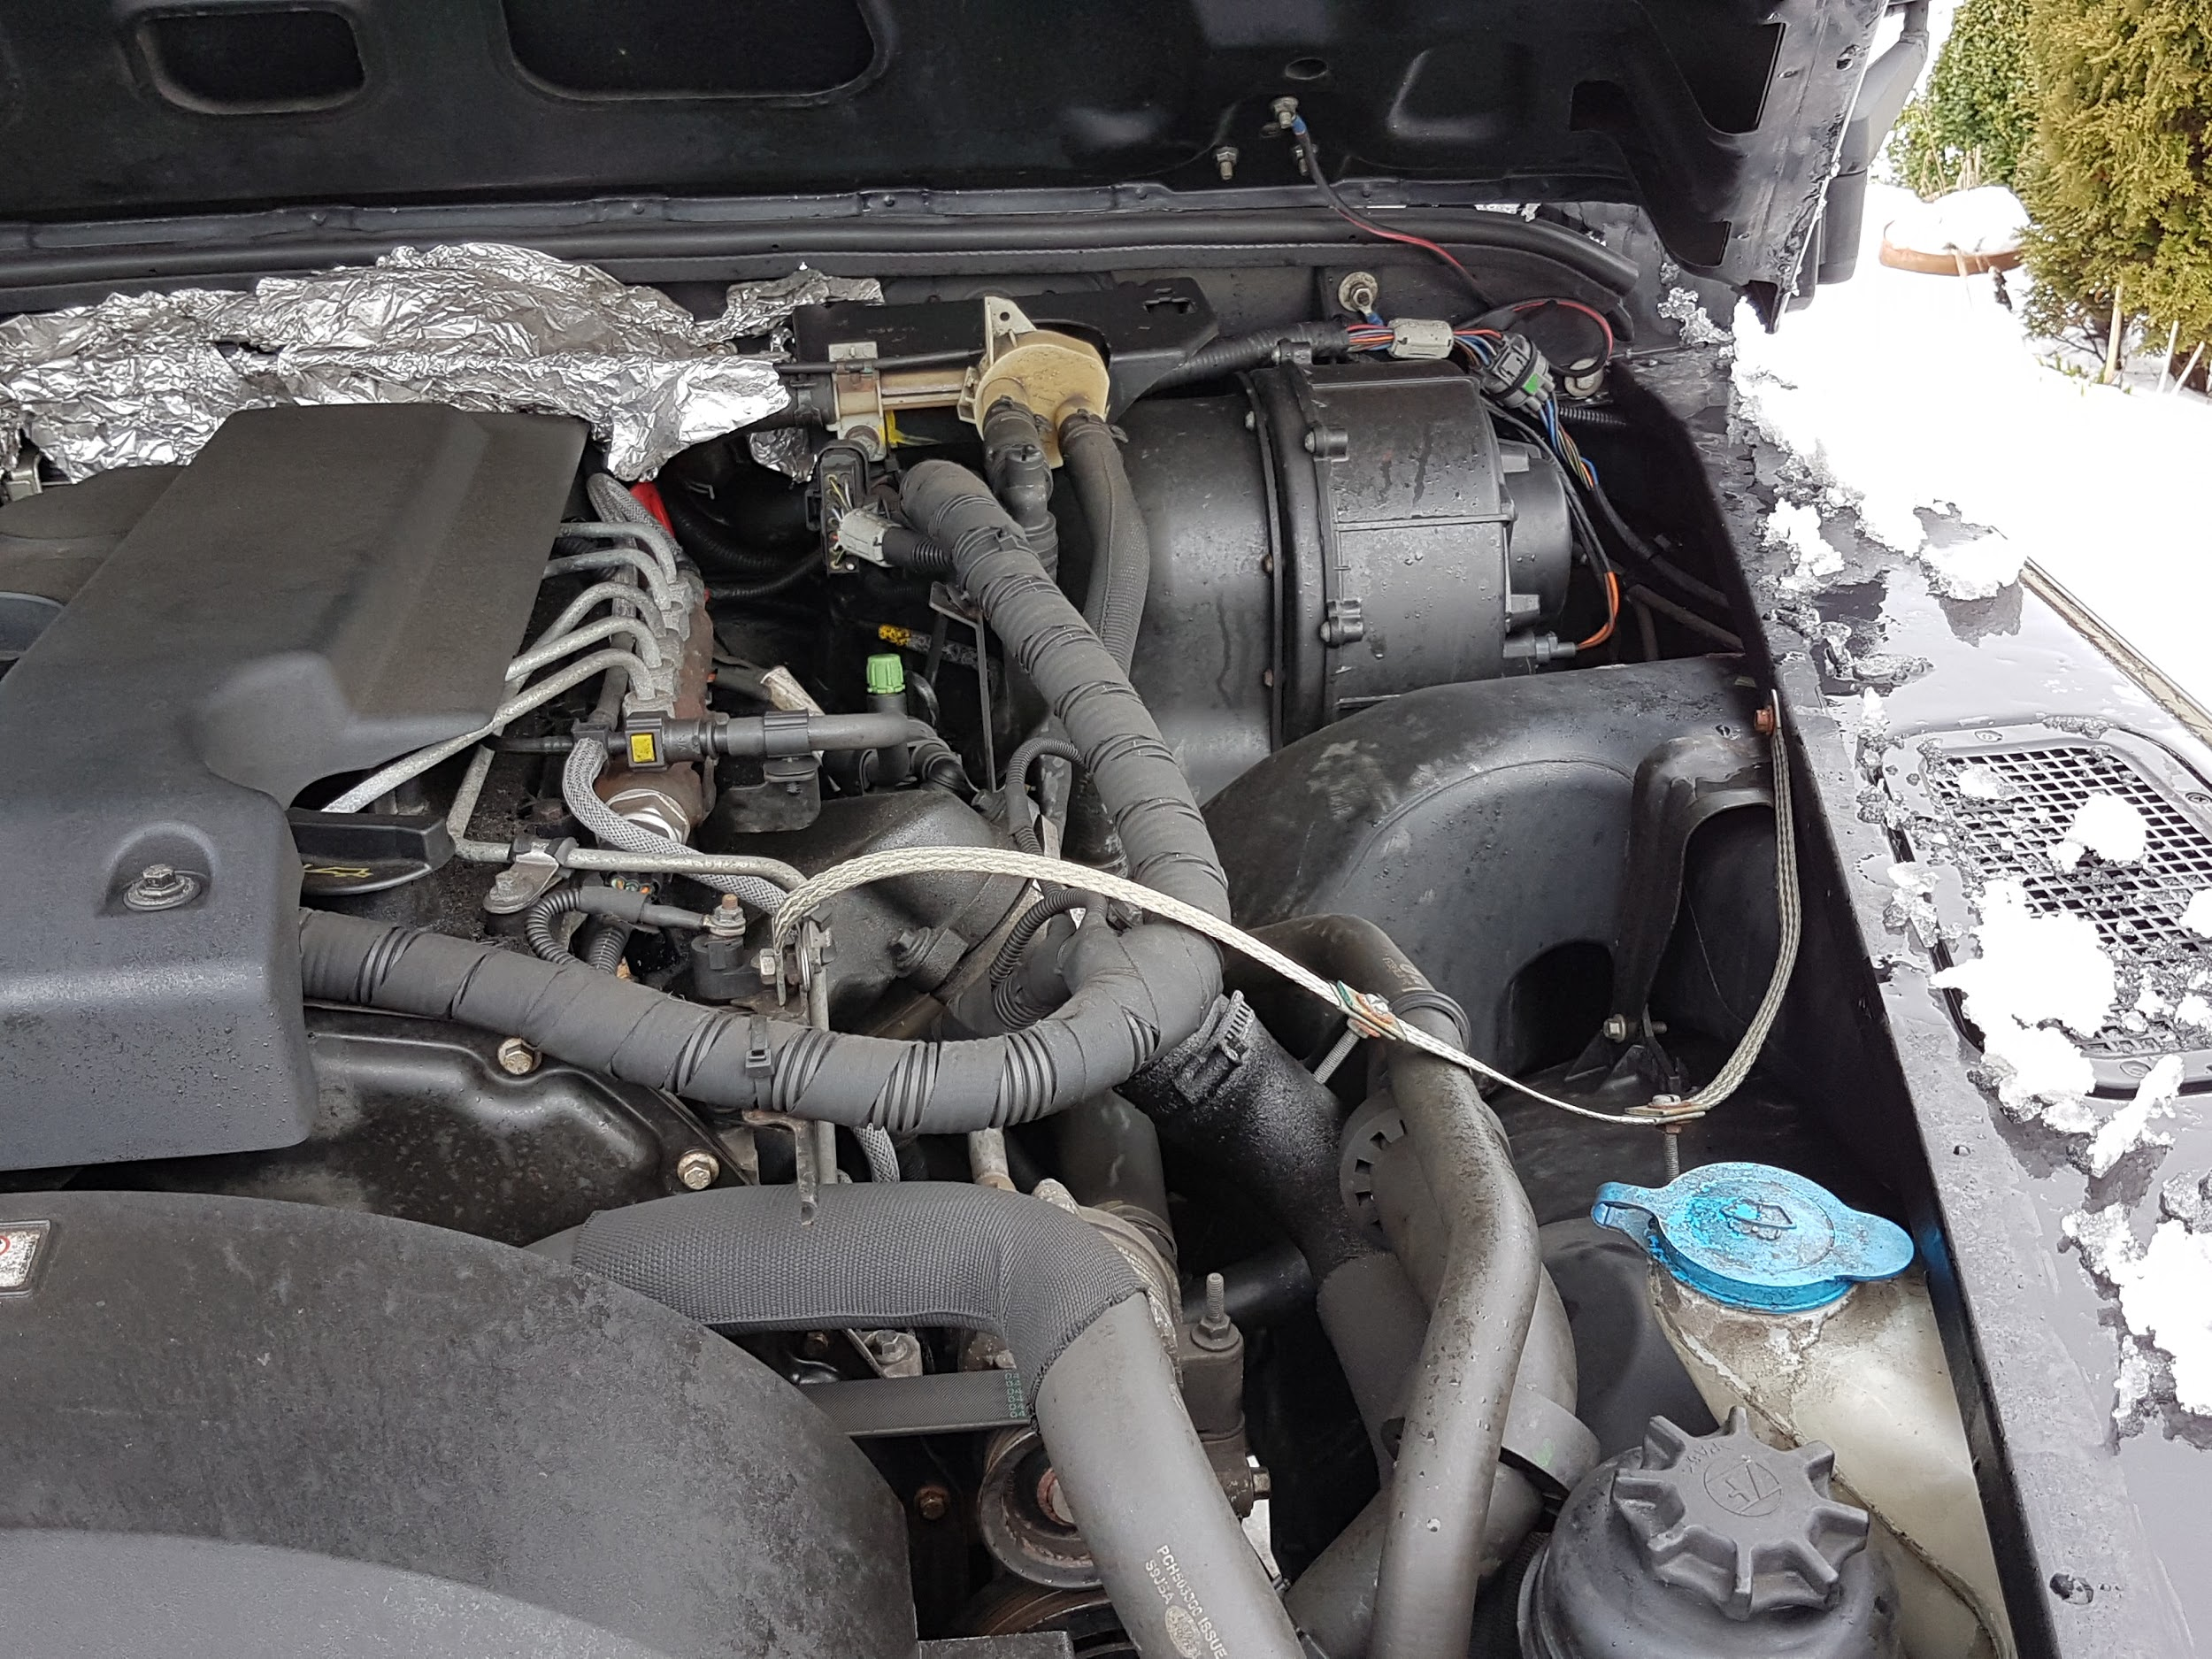
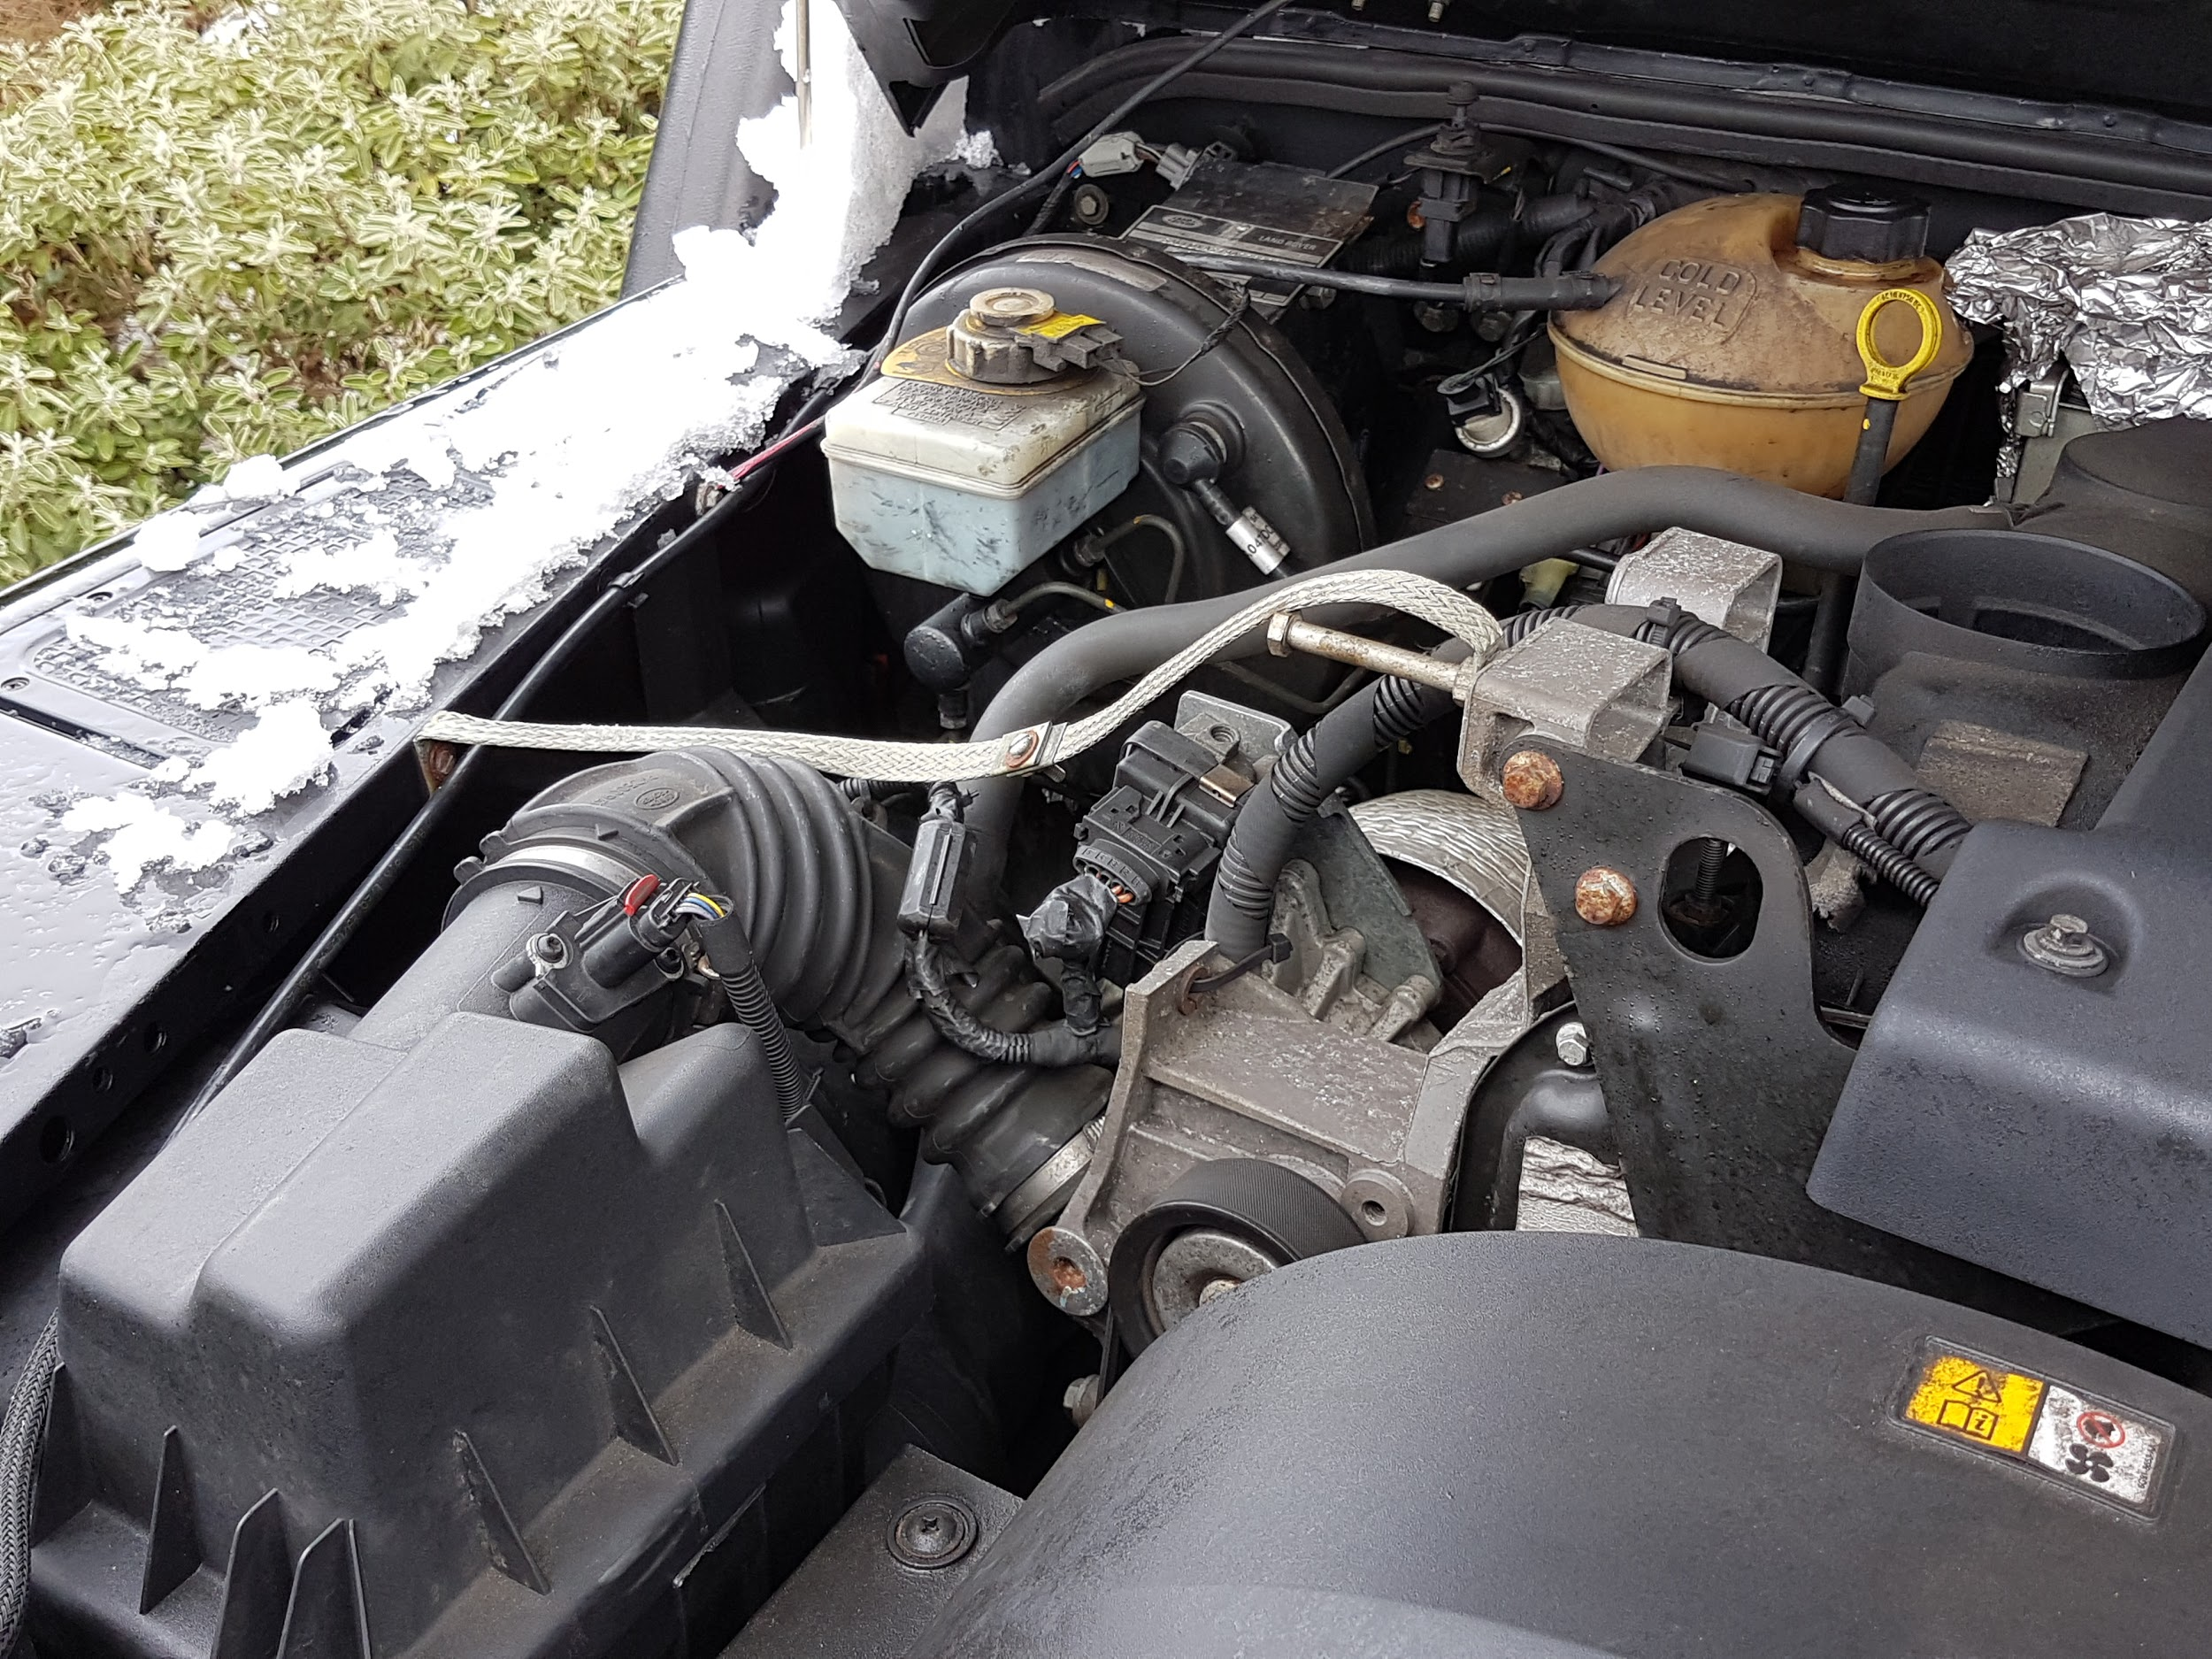
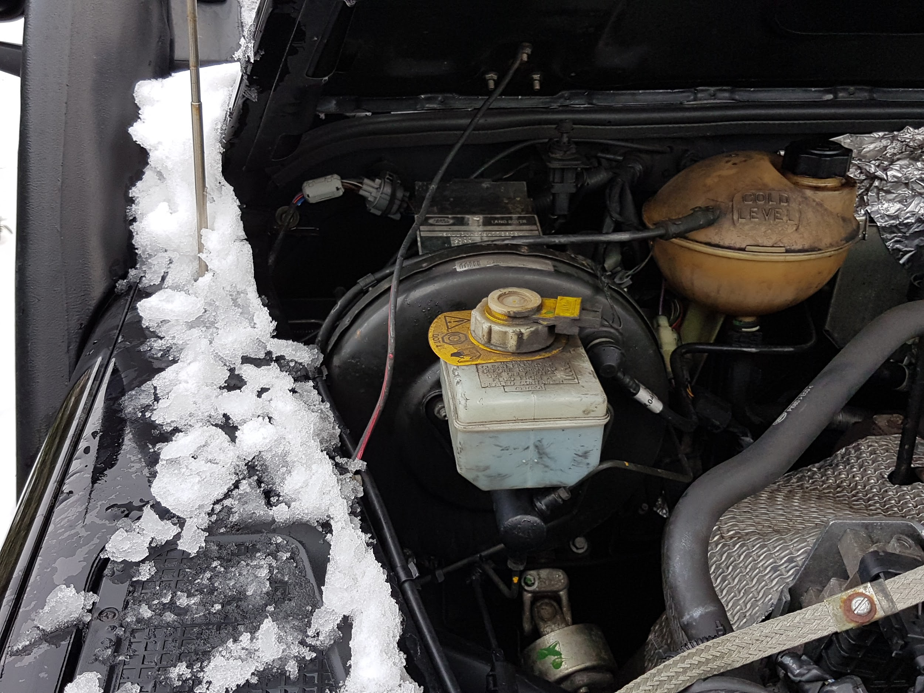
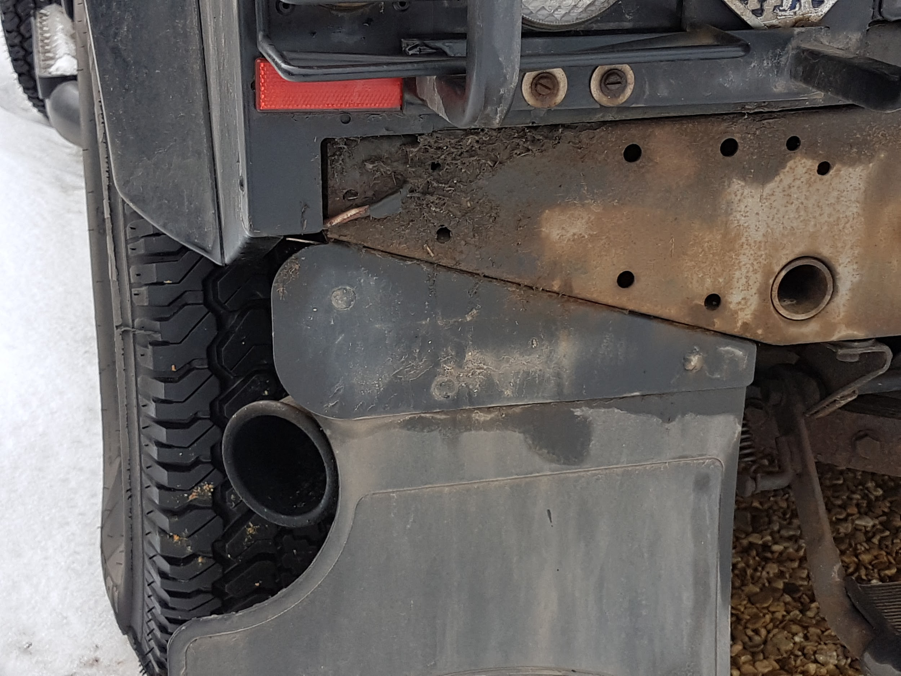
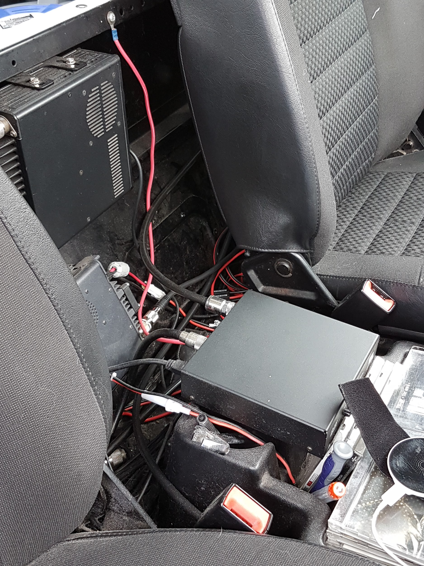
Problems Encountered
RF Ingress (engine noise, electrical systems, microprocessors etc, QRM from nearby installations
Bonding (an endless headache)!!
Tuning (restricted location in my truck)
Rig selection (cab space restrictions)

Slide 3
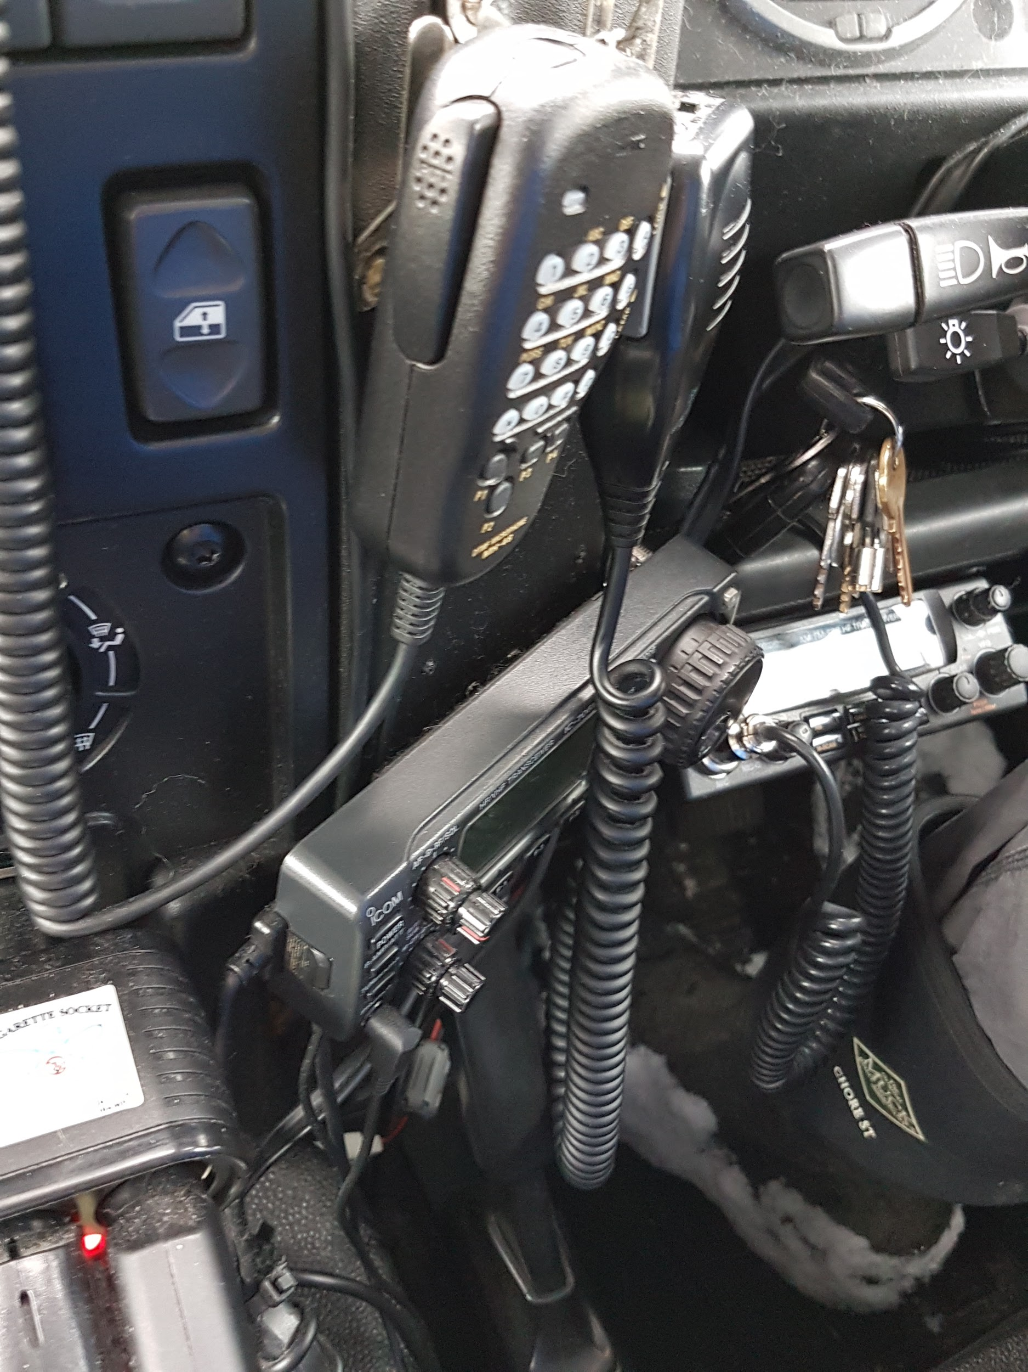
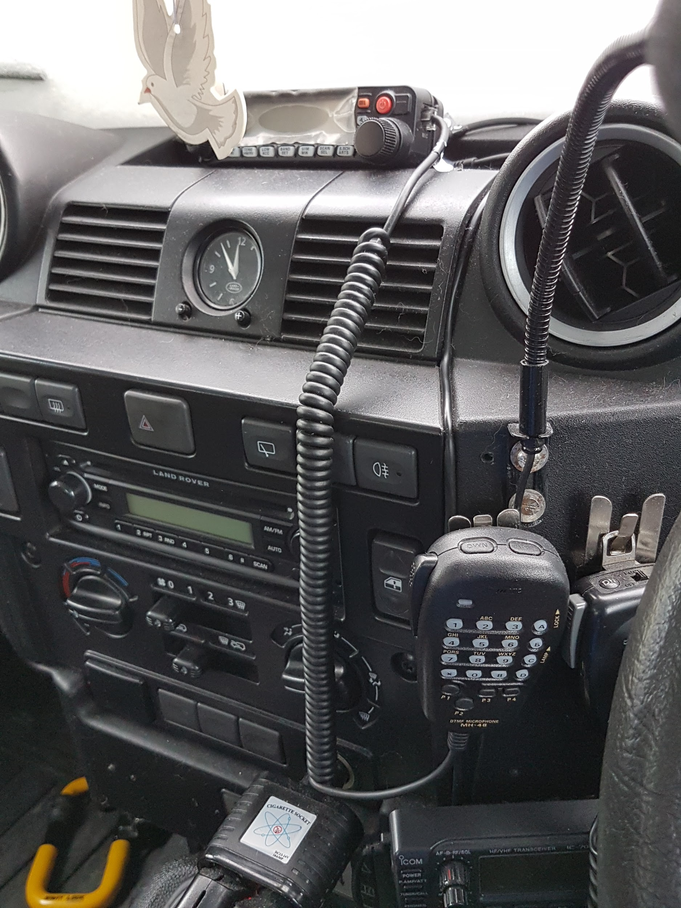
Advantages
Access to multi-locations (lends itself to field and SOTA work)
Could easily work multi-frequency work RAYNET and other mobile services
Spontaneous radio play (I get to play most days!!)
Breaks up very long journeys (even listening to contesters!!)
Potential for contact in some remote locations where phone signals are weak (feeling safer)

Slide 4
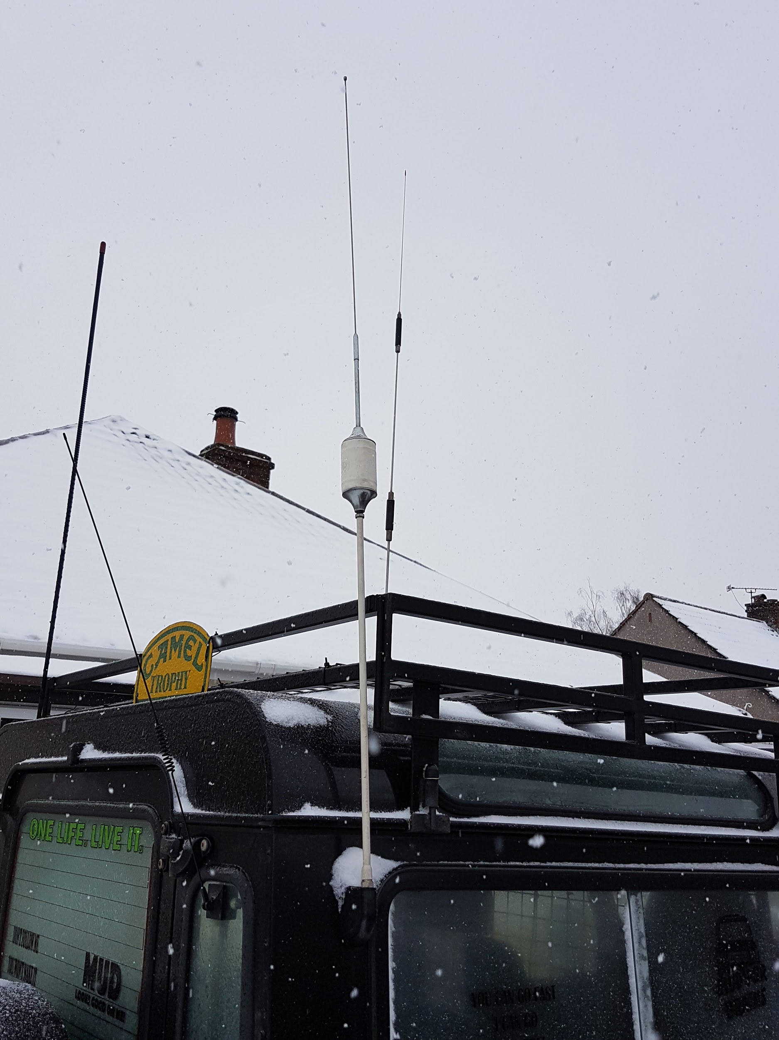
Disadvantages
Hustler antenna system chosen can only work mono-band unlike other models
Loss and antenna in-efficiencies with bonding issues and use of multi-band systems e.g. screwdrivers, ATAS etc
Height restrictions in most locations
Power restrictions
Secure mounts with heavy antennas (especially
if I use my 3.5M mast)

Slide 5
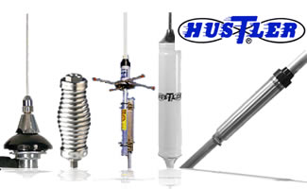
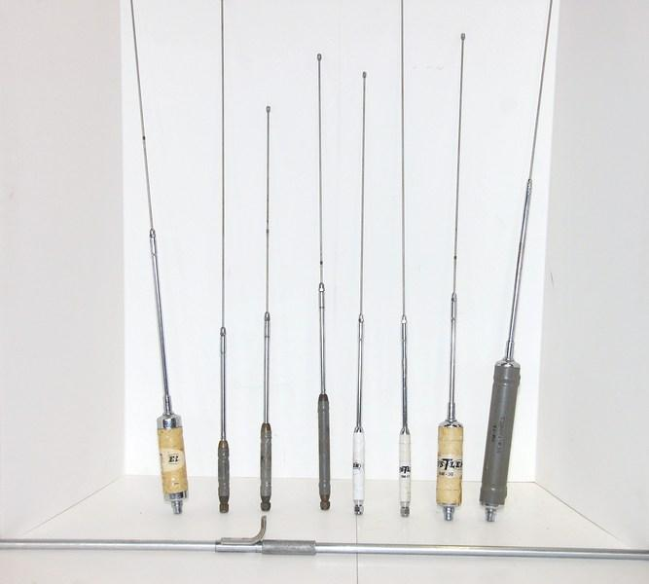
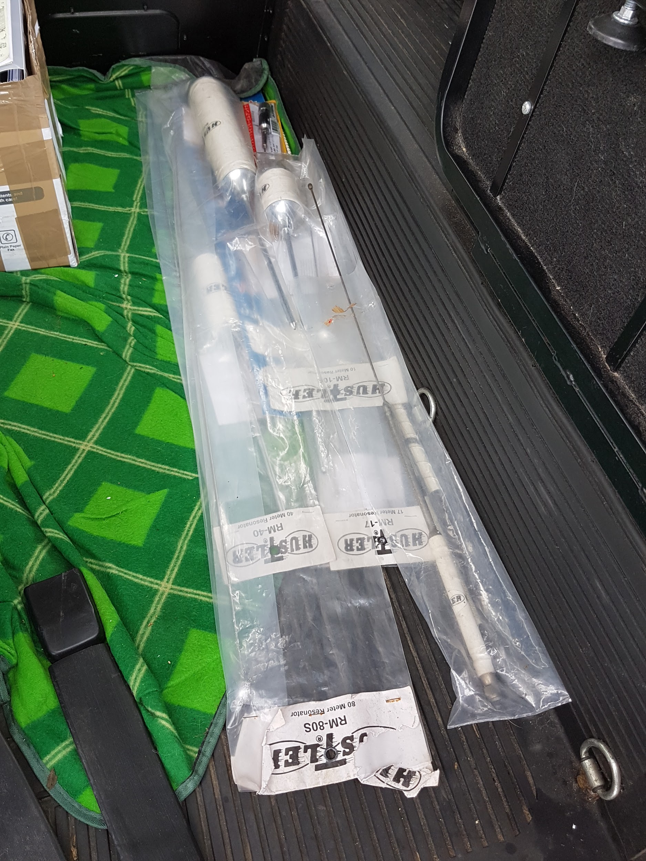
What I did - the compromise
Spoke to Andrew G0RVM and we considered his set up utilising the Hustler system
Researched the net for advice on HF mobile installations using the Hustler system and considered best way forward
Started with simpler VHF/UHF install to see what was possible e.g best site for feed line runs, ATU set-up, mounts and fixings - trial and error
Spent a month or more bonding and chasing RF ingress points on the truck after installing the systems
https://www.dxengineering.com/search/brand/hustler-antenna
https://www.breedlovemounts.com
Perseverance and patience are a must !

Slide 6
HF Contacts Made
Australia, USA, Finland, Italy, Spain, France, Poland, Russia, Romania and many more
Best RST report 59+
Average RST reports 57-8+
Most memorable Melbourne, Aus
UTC circa 07:50am 20M RST 46
Contact specifically brought me out of
the QRM as a UK QRP station!

Slide 7
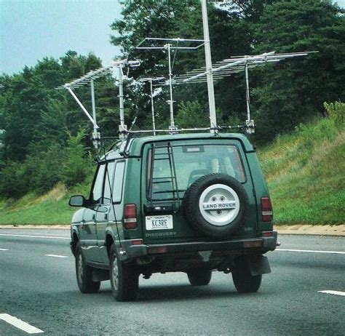
What’s next
Complete the set-up of the home shack
Consider data modes and SDR for mobile work (Andrew and I may work on this together)
Set up APRS for ARDF and such like
Consider a different antenna system e.g. modified 102 inch whip, spring and brass ball mounts (USA models) for static work
Upgrade HF rig (ICOM 7000 or similar)
Addicted to collecting mobile antennas?
There was a project in there somewhere!

Slide 8
Any Questions
The End
Thank you

